Slide 1
Selenium 4 With Java
Rex Jones II

Slide 2
Selenium 4 New Features
Install Selenium 4
W3C WebDriver Protocol
Relative Locators
Manage Windows & Tabs
Element Position with getRect()
Screenshots
Chrome DevTools Protocol (CDP)
Rex Jones II

Slide 3
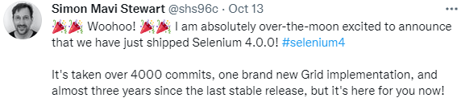
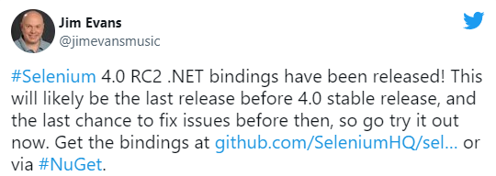
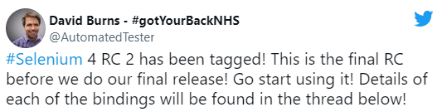
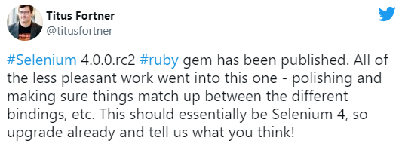
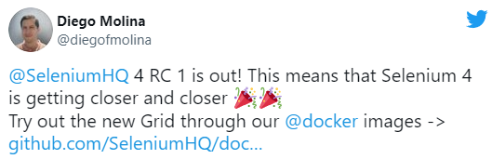
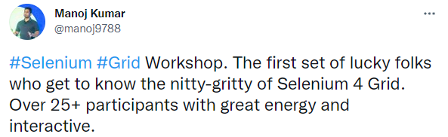

Slide 4





Selenium Architecture
Selenium Client & WebDriver Language Bindings
Browser Drivers
Web Browsers
Java
JSON Wire Protocol
ChromeDriver
Chrome
JSON Wire Protocol Over HTTP
C#
GeckoDriver
Firefox
Python
SafariDriver
Safari
Ruby
OperaDriver
Opera
JavaScript
EdgeDriver
Edge
Client
Server
Rex Jones II

Slide 5
Selenium Architecture (Direct)
Selenium Client & WebDriver Language Bindings
Browser Drivers
Web Browsers
Java
ChromeDriver
Chrome
C#
GeckoDriver
Firefox
Python
SafariDriver
Safari
Ruby
EdgeDriver
Edge
JavaScript
Client
Server
Rex Jones II

Slide 6
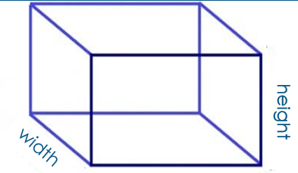
Position
y
x
Dimension
height
width
Rex Jones II

Slide 7
Selenium 3
getLocation()
getSize()
x
y
width
height
Selenium 4
getRect()
x
y
width
height
Rex Jones II

